Slide 1
8051
Microcontroller

Slide 2
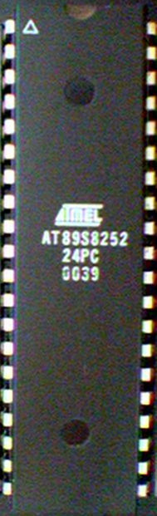
Contents
Introduction
Block Diagram and Pin Description of the 8051
Registers
Memory mapping in 8051
Stack in the 8051
I/O Port Programming
Timer
Interrupt

Slide 3
Why do we need to learn Microprocessors/controllers?
The microprocessor is the core of computer systems.
Nowadays many communication, digital entertainment, portable devices, are controlled by them.
A designer should know what types of components he needs, ways to reduce production costs and product reliable.

Slide 4
Different aspects of a microprocessor/controller
Hardware :Interface to the real world
Software :order how to deal with inputs

Slide 5
The necessary tools for a microprocessor/controller
CPU: Central Processing Unit
I/O: Input /Output
Bus: Address bus & Data bus
Memory: RAM & ROM
Timer
Interrupt
Serial Port
Parallel Port

Slide 6
Microprocessors
General-purpose microprocessor
CPU for Computers
No RAM, ROM, I/O on CPU chip itself
Example：Intel’s x86, Motorola’s 680x0
Many chips on mother’s board
Data Bus
CPU
General-Purpose Micro-processor
I/O Port
Serial COM Port
RAM
ROM
Timer
Address Bus
General-Purpose Microprocessor System
Notes:
Intel’s x86: 8086,8088,80386,80486, Pentium
Motorola’s 680x0: 68000, 68010, 68020,68030,6040

Slide 7
Microcontroller
A smaller computer
On-chip RAM, ROM, I/O ports...
Example：Motorola’s 6811, Intel’s 8051, Zilog’s Z8 and PIC 16X
CPU
RAM
ROM
A single chip
Serial COM Port
I/O Port
Timer
Microcontroller

Slide 8
Microprocessor vs. Microcontroller
Microprocessor
CPU is stand-alone, RAM, ROM, I/O, timer are separate
designer can decide on the amount of ROM, RAM and I/O ports.
expansive
versatility
general-purpose
Microcontroller
CPU, RAM, ROM, I/O and timer are all on a single chip
fix amount of on-chip ROM, RAM, I/O ports
for applications in which cost, power and space are critical
single-purpose
Notes:
versatility 多用途的: any number of applications for PC

Slide 9
Three criteria in Choosing a Microcontroller
meeting the computing needs of the task efficiently and cost effectively
  speed, the amount of ROM and RAM, the number of I/O ports and timers, size, packaging, power consumption
  easy to upgrade
  cost per unit
availability of software development tools
  assemblers, debuggers, C compilers, emulator, simulator, technical support
wide availability and reliable sources of the microcontrollers.

Slide 10

Pin Description of the 8051
P1.0
1
40
Vcc
P1.1
2
39
P0.0(AD0)
P1.2
3
38
P0.1(AD1)
P1.3
4
8051
37
P0.2(AD2)
P1.4
5
36
P0.3(AD3)
P1.5
6
35
P0.4(AD4)
P1.6
7
34
P0.5(AD5)
P1.7
8
33
P0.6(AD6)
RST
9
32
P0.7(AD7)
(RXD)P3.0
10
31
EA/VPP
(TXD)P3.1
11
30
ALE/PROG
(INT0)P3.2
12
29
PSEN
(INT1)P3.3
13
28
P2.7(A15)
(T0)P3.4
14
27
P2.6(A14)
(T1)P3.5
15
26
P2.5(A13)
(WR)P3.6
16
25
P2.4(A12)
(RD)P3.7
17
24
P2.3(A11)
XTAL2
18
23
P2.2(A10)
XTAL1
19
22
P2.1(A9)
GND
20
21
P2.0(A8)


Slide 11
MNEMONIC | TYPE | NAME AND FUNCTION
Vss | I | Ground 0 V reference.
Vcc | I | Power Supply: This is the power supply voltage for normal, idle, and power-down operation.
P0.0 - P0.7 | I/O | Port 0 is an open-drain, bi-directional I/O port. Port 0 pins that have 1's written to them float and can be used as high-impedance inputs. Port 0 is also the multiplexed low-order address and data bus during accesses to external program and data memory. In this application, it uses strong internal pull-ups when emitting 1's.
P1.0 - P1.7 | I/O | Port 1: Port I is an 8-bit bi-directional I/O port with internal pull-ups. Port 1 pins that have 1's written to them are pulled high by the internal pull-ups and can be used as inputs. As inputs, Port 1 pins that are externally pulled low will source current because of the internal pull-ups. Alternate functions for C52, Fx and RX series Port 1 include:

Slide 12
P2.0 - P2.7 | I/O | Port 2 is an 8-bit bidirectional I/O Port with internal pull ups. Port 2 pins that have 1's written to them are pulled high by the internal pull-ups and can be used as inputs. As inputs, Port 2 pins that are externally being pulled low will source current because of the internal pull-up. Port 2 emits the high order address byte during fetches from external program memory and during accesses to external data memory that use 16 bit addresses; (MOVX@ DPTR). In this application, it uses strong internal pull ups when emitting 1's. During accesses to external data memory that use 8 bit addresses; (MOV @R0), Port 2 emits the contents of the P2 special function register.
P3.0 - P3.7 | I/O | Port 3 is an 8 bit bidirectional I/O port with internal pull-up. Port 3 pins that have 1's written to then are pulled high by the internal pull-ups and can be used as inputs. Port 3 pins that are externally being pulled low will source current because of the pull-up. Port 3 also serves special features as shown below:

Slide 13
RST | I | Reset A high on this pin for two machine cycles while the oscillator is running, resets the device. An internal resistor to Vss permits a power-on reset using only an external capacitor to VCC.
ALE | O | Address Latch Enable: Output pulse for latching the low byte of the address during an access to external memory. In normal operation, ALE is emitted twice every machine cycle, and can be used for external timing or clocking. Note that one ALE pulse is skipped during each access to external data memory. ALE can be disabled by setting SFR auxiliary.0. With this bit set, ALE will be active only during a MOVX instruction.
PSEN* | O | Program Store Enable: The read strobe to external program memory. When executing code from the external program memory, PSEN* is activated twice each machine cycle, except that two PSEN* activations are skipped during each access to external data memory. PSEN* is not activated during fetches from Internal program memory.
EA*/VPP | I | External Access Enable/Programming Supply Voltage: EA* must be externally held low to enable the device to fetch code from external program memory locations. If EA* Is held high, the device executes from internal program memory. The value on the EA* pin is latched when RST is released and any subsequent changes have no effect. This pin also receives the programming supply voltage Vpp during Flash programming. (applies for 89c5x MCU's)

Slide 14
General Block Diagram
External interrupts
On-chip ROM for program code
Timer/Counter
Interrupt Control
On-chip RAM
Timer 1
Counter Inputs
Timer 0
CPU
Bus Control
Serial Port
4 I/O Ports
OSC
P0 P1 P2 P3
TxD RxD
Address/Data

Slide 15
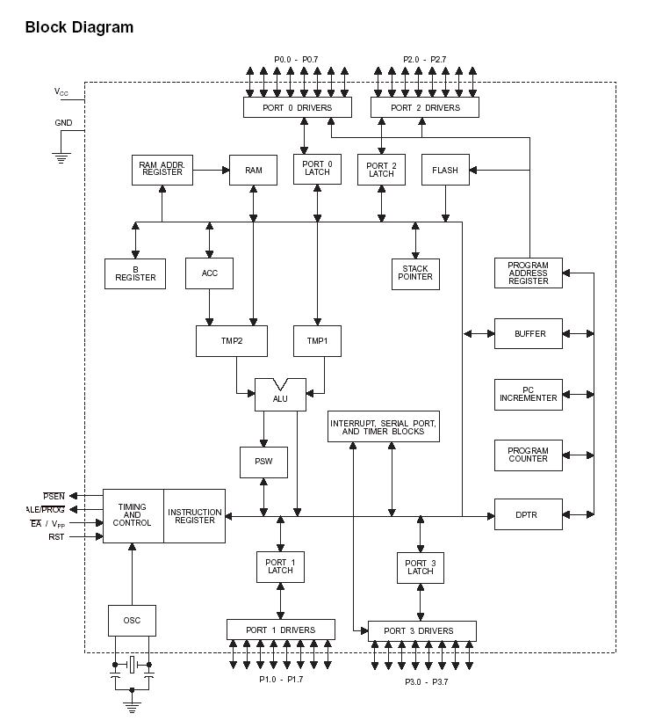

Slide 16
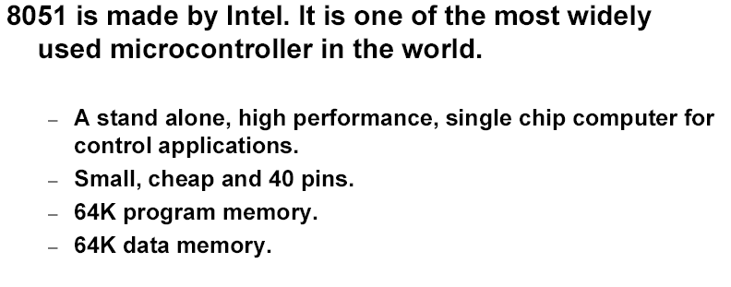
8051 Features
Hardware Interrupts
  Timer Flags
  Serial Port

Slide 17
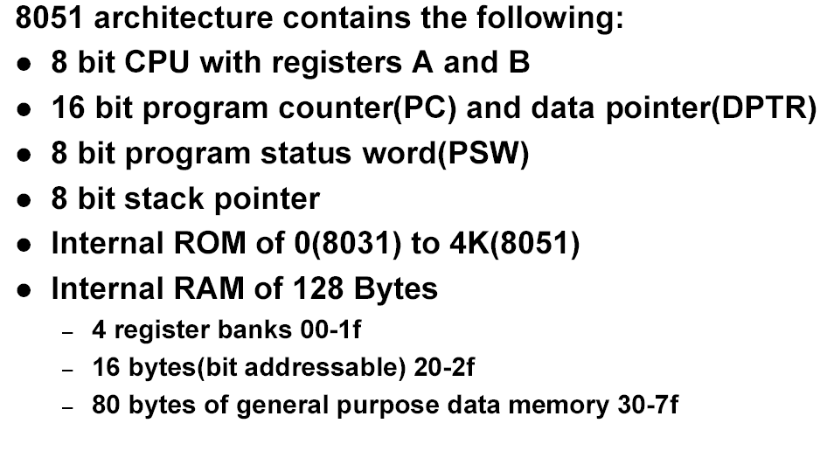
8051 Architecture

Slide 18
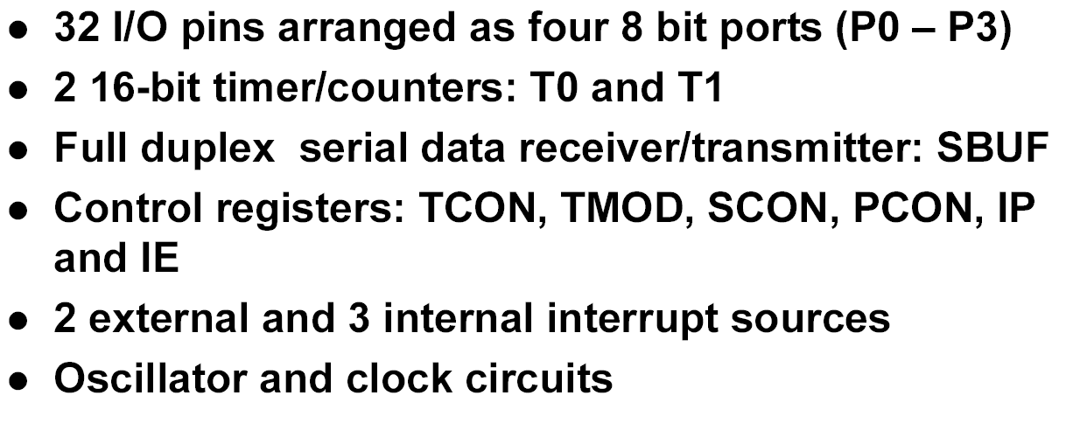
Architecture cont…

Slide 19
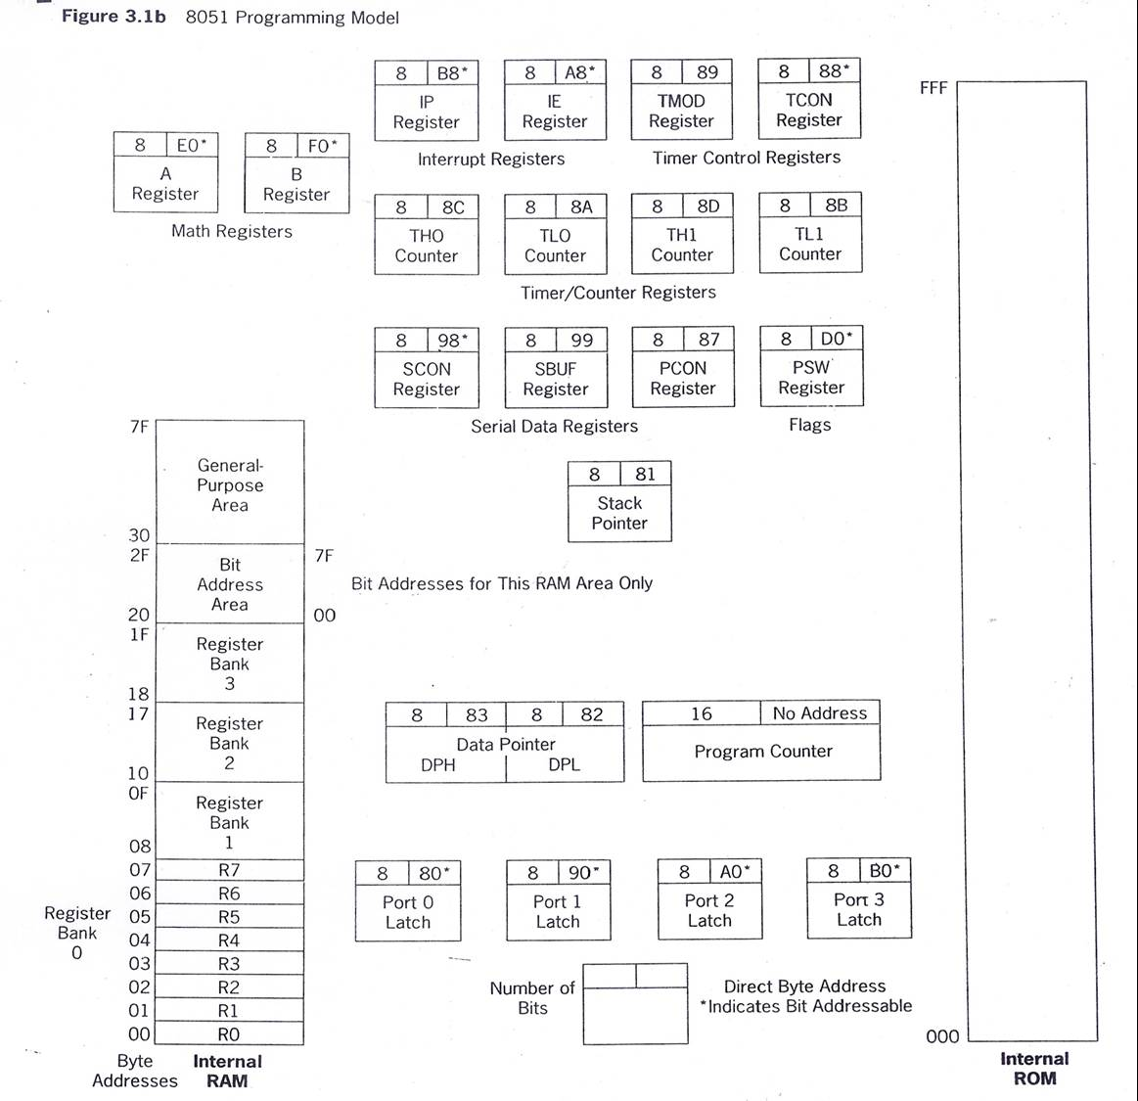

Slide 20
Special Function Registers
A
B
R0
DPTR
DPH
DPL
R1
R2
PC
PC
R3
R4
Some 8051 16-bit Register
R5
R6
R7
Some 8-bit Registers of the 8051

Slide 21
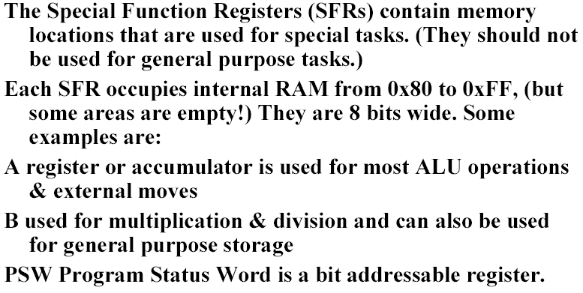
Special Function Registers

Slide 22
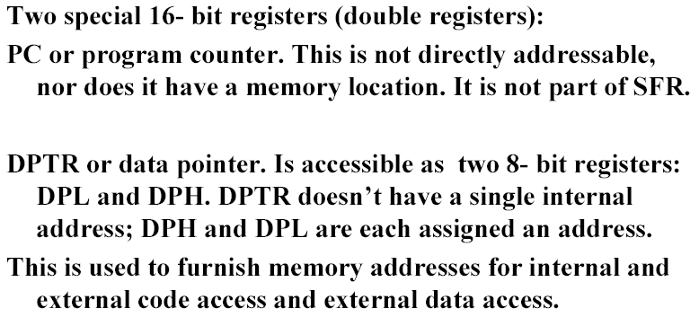
Special Function Registers

Slide 23
The Accumulator
General register to accumulate the results.
Can hold an 8-bit (1-byte) value
The "B" Register
Very similar to the Accumulator.
It may hold an 8-bit (1-byte) value.
The "B" register is only used by two 8051 instructions:
MUL AB and DIV AB.
Thus, if you want to quickly and easily multiply or divide A by
another number, you may store the other number in "B" and make
use of these two instructions.
Temporary storage register much like a ninth "R" register.
The "R" registers
R0, R1, etc. up to and including R7.
Auxiliary registers in many operations.

Slide 24
The Data Pointer (DPTR)
Only user-accessable 16-bit (2-byte) register.
Is used to point to data.
Allow the 8051 to access external memory.
Access external memory at the address indicated by DPTR.
Often used to store 2-byte values
The Program Counter (PC)
2-byte address which tells where the next instruction to execute is.
PC always starts at 0000h and is incremented each time.
PC will be incremented by 2 or 3 in 2/3 byte instruction cases.
No way to directly modify its value.
No way to read the value of PC.
The Stack Pointer (SP)
hold an 8-bit (1-byte) value.
8051 first increments the value of SP and then stores the value
SP is modified directly by the 8051 by six instructions: PUSH, POP, ACALL, LCALL, RET, and RETI

Slide 25
Timer SFRs
8051 has 2 timers which function the same way.
One timer is TIMER0 and the other is TIMER1.
The two timers share two SFRs (TMOD and TCON).
Each timer also has two SFRs (TH0/TL0 and
TH1/TL1).
SFR Name | Description | SFR Address
TH0 | Timer 0 High Byte | 8Ch
TL0 | Timer 0 Low Byte | 8Ah
TH1 | Timer 1 High Byte | 8Dh
TL1 | Timer 1 Low Byte | 8Bh
TCON | Timer Control | 88h
TMOD | Timer Mode | 89h

Slide 26
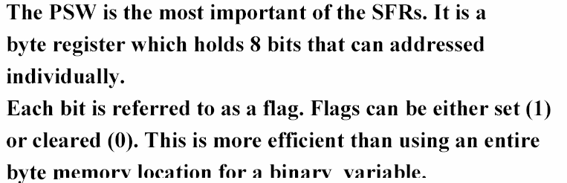
Program Status Word
C AC F0 RS1 RS0 OV F1 P
Carry
Parity
Auxiliary Carry
User Flag 1
User Flag 0
Register Bank Select
Overflow

Slide 27
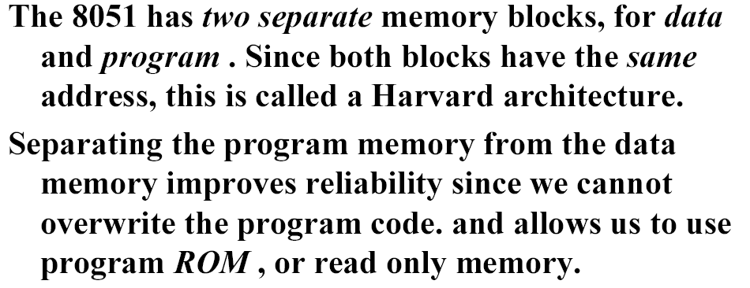
8051 Memory

Slide 28
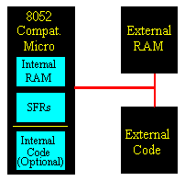
The 8051 has three very general types of memory. To effectively program the 8051 it is necessary to have a basic understanding of these memory types.
The memory types are illustrated in the following graphic. They are:
On-Chip Memory
External Code Memory
External RAM.

Slide 29
On-Chip Memory refers to any memory (Code, RAM, or other) that physically exists on the microcontroller itself. On-chip memory can be of several types, but we'll get into that shortly.
External Code Memory is code (or program) memory that resides off-chip. This is often in the form of an external EPROM.
External RAM is RAM memory that resides off-chip. This is often in the form of standard static RAM or flash RAM.

Slide 30
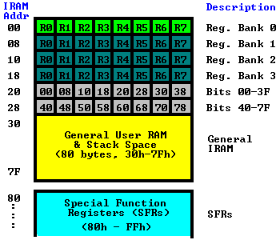
On-Chip Memory
On-chip memory is really one of two types:
Internal RAM
Special Function Register (SFR) memory.
The layout of the 8051's internal memory is presented in the following memory map:

Slide 31
Memory Organization
The 8051 memory organization is rather complex.
The 8051 has separate address spaces for Program Memory and Data Memory.
This is referred to as a Harvard architecture.
Both program memory and data memory are 8 bits wide and use 16 bits of address.
Since the same address can refer to different locations the specific location is determined by the type of instruction.

Slide 32
Program or Code Memory
Consist of internal or external program memory. The amount of internal program memory varies depending on the device.
  4K bytes typical in older devices.
The MOVC instruction can be use to read code memory.
To reference code memory I will use the notation:
CM = CM(0,…,FFFFH) = CM(0,…,FFFFH; 7,…,0)
This notation can be used to specify particular bits and bytes of code memory.
For example CM(1234H) refers to the byte of code memory at address 1234H. CM(1234H;7) refers to the most significant bit in that address.

Slide 33
External Memory
Supports up to 64K bytes external memory.
  XM(0000,…,FFFF)
  = XM(0000,…,FFFF; 7,…,0)
  Accessed by using the MOVX instruction.
Using external memory reduces number of available I/O ports.

Slide 34
Data Memory
The 8051 has 128 bytes of on-chip RAM.
  This memory includes 4 banks of general purpose registers at DM(00..1F)
  Only one bank can be active at a time.
  If all four banks are used, DM(20..7F) is available for program data.
  DM(20..2F) is bit addressable as BADM(00..7F).
DM(80,…,FF) contains the special function registers such as I/O ports, timers, UART, etc.
  Some of these are bit addressable using BADM(80..FF)

Slide 35
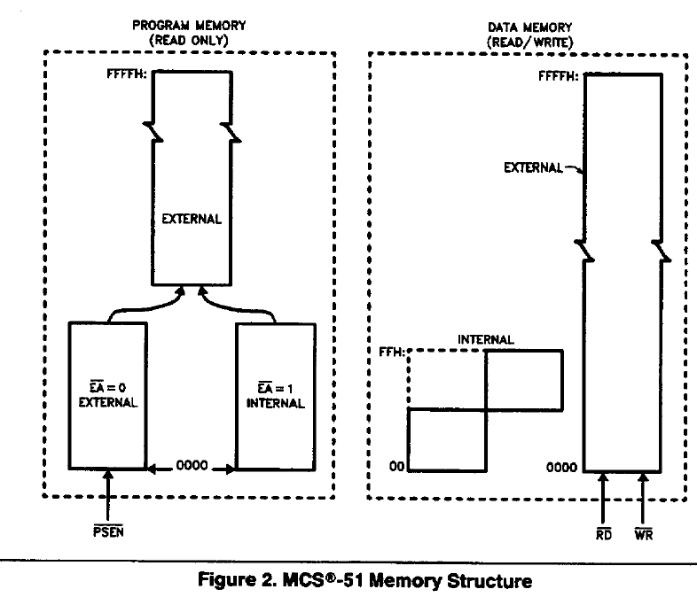

Slide 36
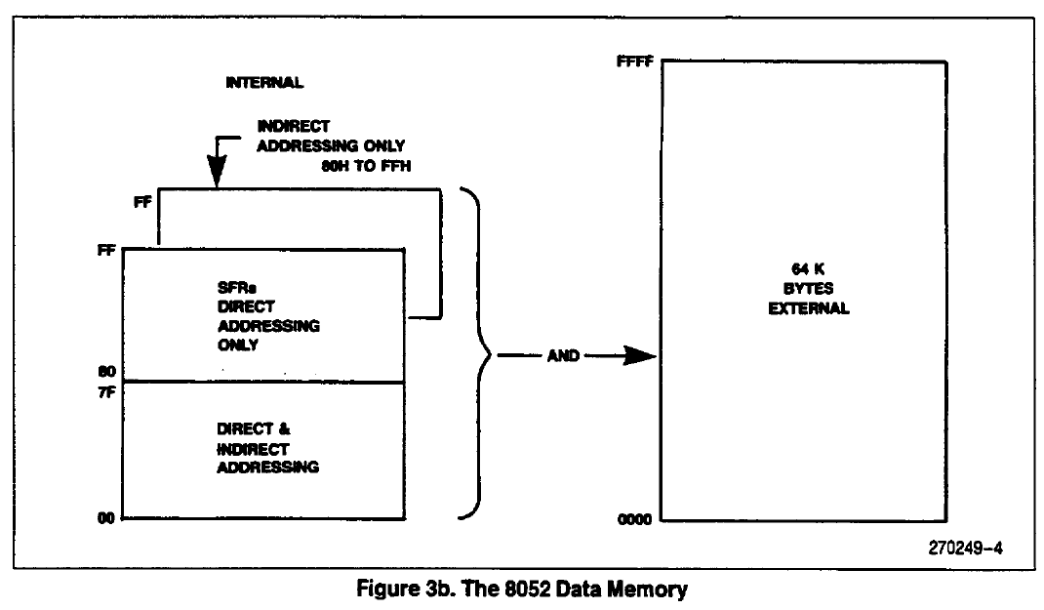

Slide 37
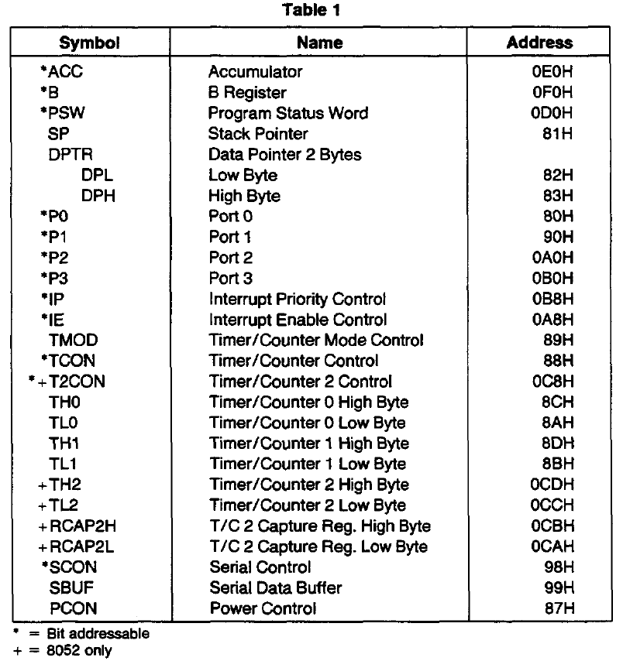

Slide 38
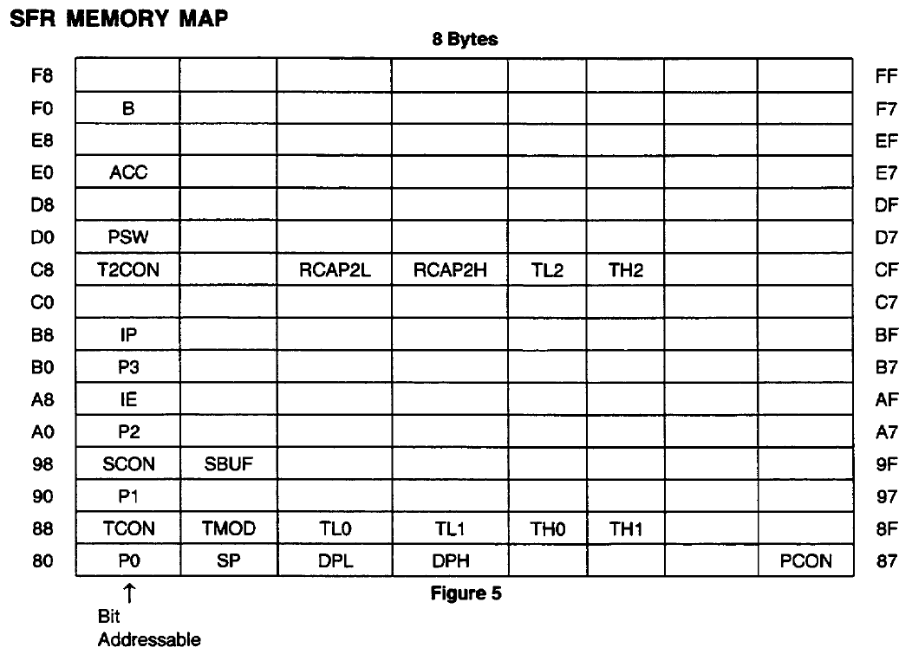

Slide 39
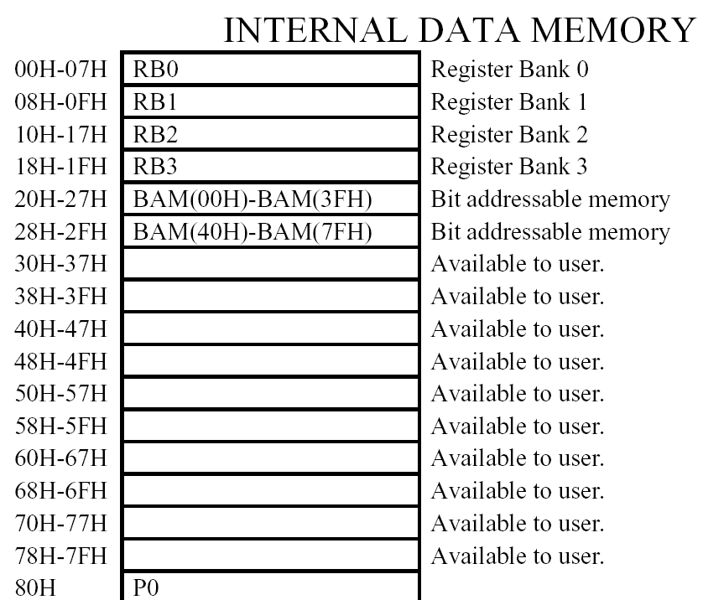

Slide 40
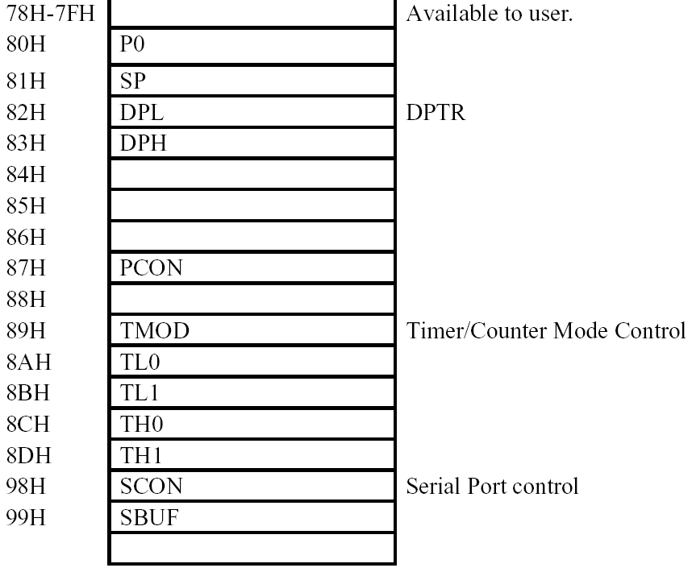

Slide 41
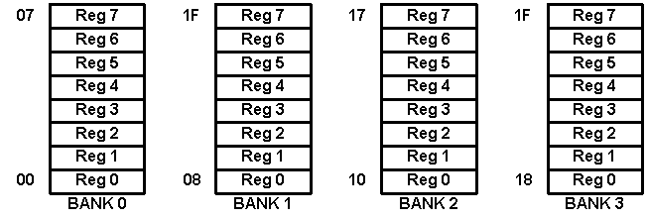
Register Banks

Slide 42
Stack in the 8051
The register used to access the stack is called SP (stack pointer) register.
The stack pointer in the 8051 is only 8 bits wide, which means that it can take value 00 to FFH. When 8051 powered up, the SP register contains value 07.
7FH
Scratch pad RAM
30H
2FH
Bit-Addressable RAM
20H
1FH
Register Bank 3
18H
17H
Register Bank 2
10H
0FH
(Stack) Register Bank 1
08H
07H
Register Bank 0
00H

Slide 43
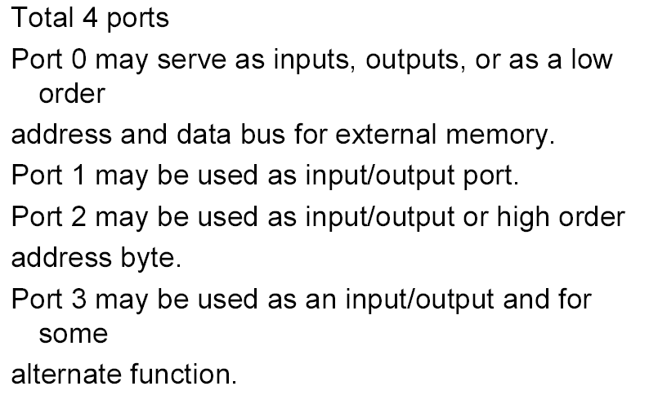
8051 PORTS
The standard 8051 architecture provides four 8 bit I/O ports. Basic programming involves the use of,
Byte transfer & Bit manipulation

Slide 44
Port 3 Alternate Functions
P3 Bit
Function
Pin
P3.0
RxD
10
P3.1
TxD
11
P3.2
INT0
12
P3.3
INT1
13
P3.4
T0
14
P3.5
T1
15
P3.6
WR
16
P3.7
RD
17


Slide 45
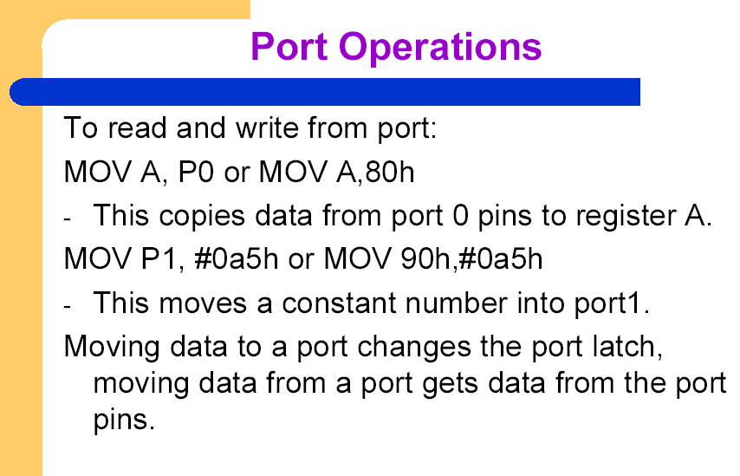

Slide 46
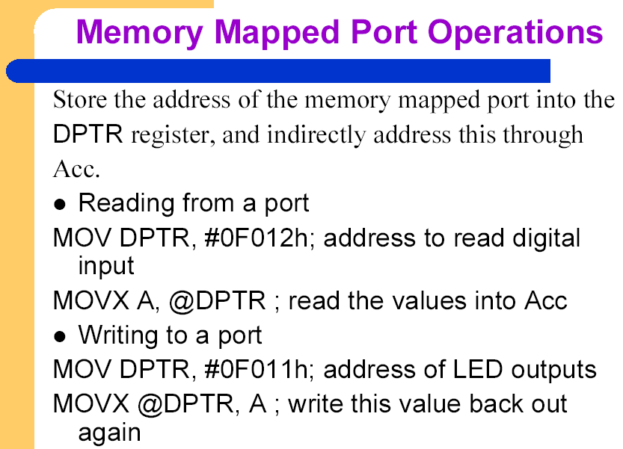

Slide 47
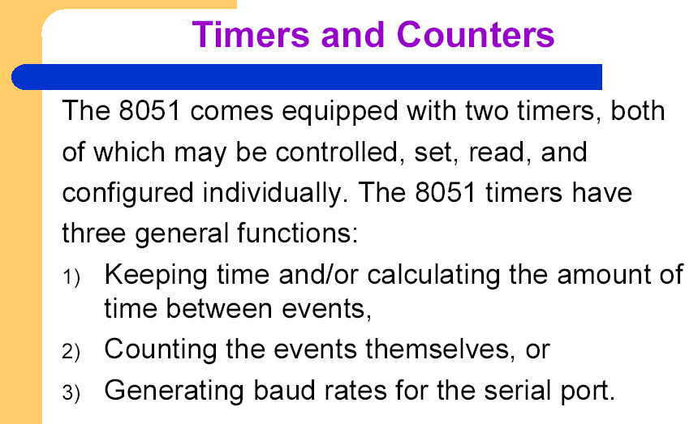
Two 8/16 bit timers with Four Operating Modes

Slide 48
The timers and counters are used for:
generating time delays
measuring pulse durations or timing intervals
counting pulses or events
implementing multi-tasking pre-emptive systems
generating interrupts
There are TWO timer counters supported by the 8051.
They can be used as sixteen bit OR eight bit counters.
An interrupt service routine (ISR) is invoked each time the timer overflows (goes from 0xFFFF to 0x0000). In the ISR, the overflow_count variable increments.

Slide 49
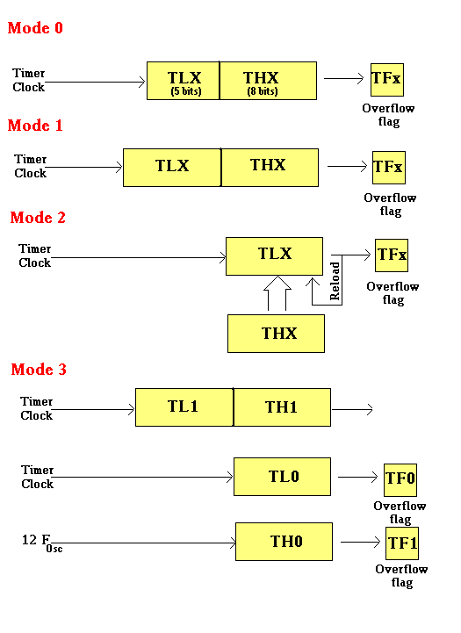
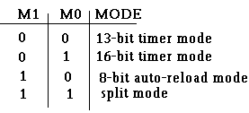
The Timer Run Bits TR1 and TR0 (Register TCON) enable timers if set to logic 1. When these bits are set to logic zero, timing/counting is disabled.

Slide 50
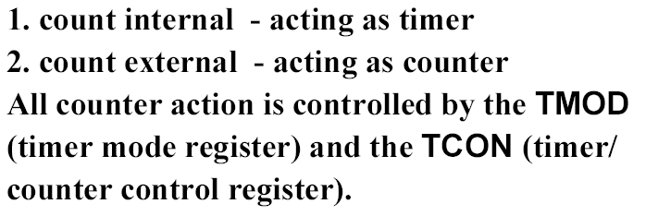
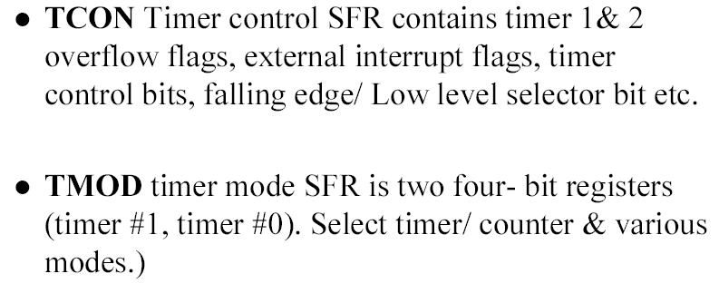
Timer Modes

Slide 51
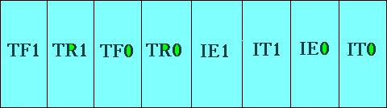
TCON Register
TF1: Timer 1 overflow flag.
TR1: Timer 1 run control bit.
TF0: Timer 0 overflag.
TR0: Timer 0 run control bit.
IT0 : 0 – Low Level Triggered
1 – Neg Edge Triggered
IE0 : Set when Interrupt O
Requested
IT1 : same as IT0
IE1 : Set when Interrupt 1
Requested

Slide 52
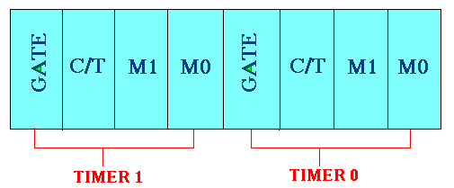
TMOD Register
C/T: 0=Internal Instr. Clock(clock/12)
1=External Clock
Gate : When set, timer only runs while INT(0,1) is high.
C/T : Counter/Timer select bit.
M1 : Mode bit 1.
M0 : Mode bit 0.

Slide 53
Timer Modes
13-bit Time Mode (mode 0)
To maintain compatibility with its predecessor, the 8048.
When the timer is in 13-bit mode, only bits 0-4 of TLx and bits 0-7 of THx are used.
Can only contain 8192 values. If you set a 13-bit timer to 0, it will overflow back to zero 8192 machine cycles later.
16-bit Time Mode (mode 1)
contain up to 65536 distinct values.
TLx is incremented from 0 to 255.
Then it resets to 0 and causes THx to be incremented by 1.
It will overflow back to 0 after 65,536 machine cycles.

Slide 54
Timer Modes
8-bit Time Mode (mode 2)
8-bit auto-reload mode.
THx holds the "reload value" and TLx is the timer itself.
instead of resetting to 0 ,it will be reset to the value stored in THx.
Split Timer Mode (mode 3)
Becomes two separate 8-bit timers.
Timer 0 is TL0 and Timer 1 is TH0. Both timers count from 0 to 255 and overflow back to 0.
While Timer 0 is in split mode, the real Timer 1 (i.e. TH1 and TL1) can be put into modes 0, 1 or 2

Slide 55
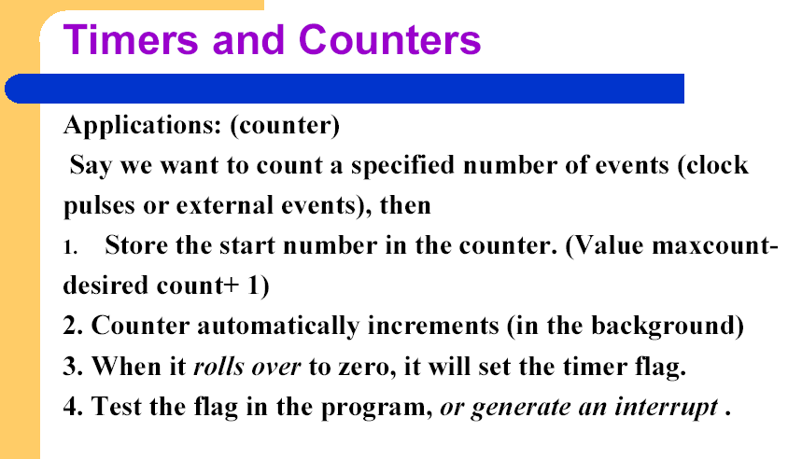

Slide 56
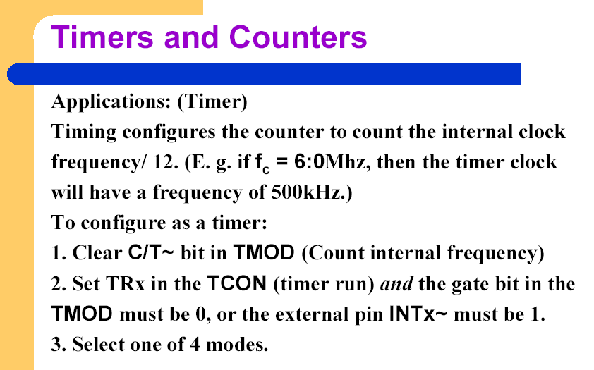

Slide 57
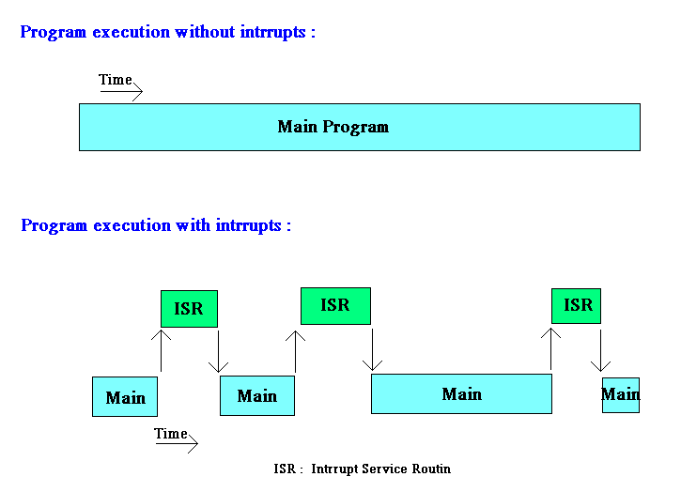
Interrupt

Slide 58
What Events Can Trigger Interrupts, and where do they go?
We can configure the 8051 so that any of the following events will cause an interrupt:
Timer 0 Overflow.
Timer 1 Overflow.
Reception/Transmission of Serial Character.
External Event 0.
External Event 1.
In other words, we can configure the 8051 so that when Timer 0 Overflows or when a character is sent/received, the appropriate interrupt handler routines are called.

Slide 59
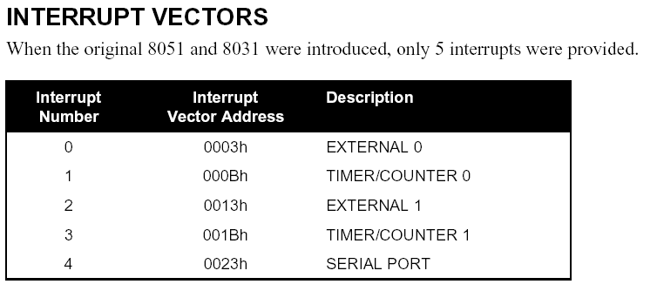
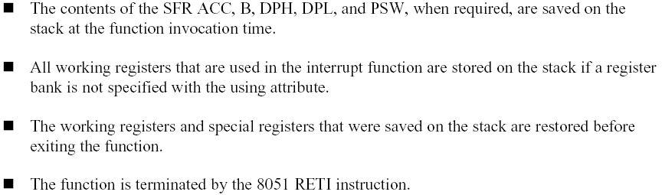

Slide 60
The various registers associated with the use of interrupts are:
TCON - Edge and Type bits for External Interrupts 0/1
SCON - RI and TI interrupt flags for RS232
IE - Enable interrupt sources
IP - Specify priority of interrupts

Slide 61
Polling Sequence
The 8051 automatically evaluates whether an interrupt should occur after
every instruction. When checking for interrupt conditions, it checks them in
the following order:
External 0 Interrupt
Timer 0 Interrupt
External 1 Interrupt
Timer 1 Interrupt
Serial Interrupt
This means that if a Serial Interrupt occurs at the exact same instant that
an External 0 Interrupt occurs, the External 0 Interrupt will be executed first
and the Serial Interrupt will be executed once the External 0 Interrupt has
completed.

Slide 62
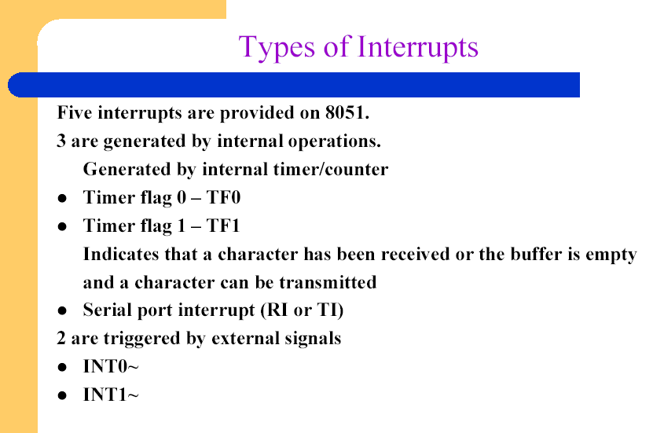

Slide 63
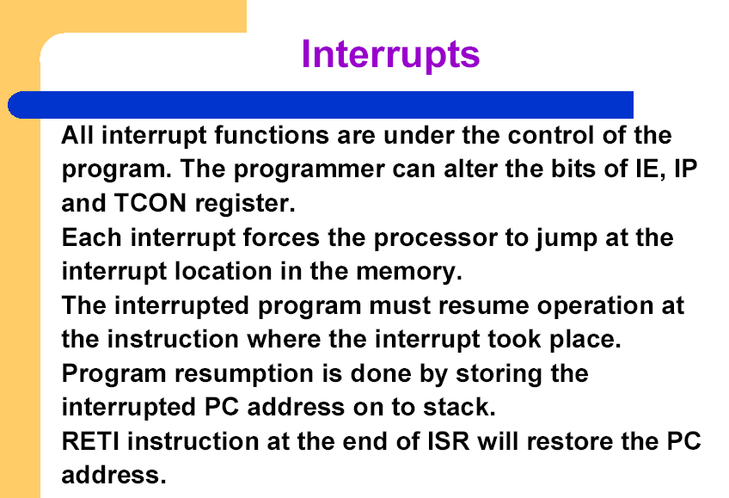

Slide 64
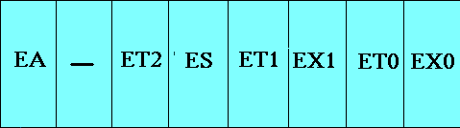
Interrupt Enable Register
--
EA : Global enable/disable.
--- : Reserved for additional interrupt
hardware.
ES : Enable Serial port interrupt.
ET1 : Enable Timer 1 control bit.
EX1 : Enable External 1 interrupt.
ET0 : Enable Timer 0 control bit.
EX0 : Enable External 0 interrupt.
MOV IE,#08h
or
SETB ET1

Slide 65
Interrupt Priority Register
PS PT1 PX1 PT0 PX0
Reserved
Serial Port
INT 0 Pin
Timer 1 Pin
INT 1 Pin
Timer 0 Pin

Slide 66
When considering interrupt priorities, the following rules apply:
Nothing can interrupt a high-priority interrupt--not even another high priority interrupt.
A high-priority interrupt may interrupt a low-priority interrupt.
A low-priority interrupt may only occur if no other interrupt is already executing.
If two interrupts occur at the same time, the interrupt with higher priority will execute first. If both interrupts are of the same priority the interrupt which is serviced first by polling sequence will be executed first.

Slide 67
Serial I/O
Synchronous and Asynchronous
SCON Register is used to Control
Data Transfer through RXd pin
Clock through TXd Pin
Four Modes of Operation
Mode 0 :Synchronous Serial Communication
Mode 1 :8-Bit UART with Timer Data Rate
Mode 2 :9-Bit UART with Set Data Rate
Mode 3 :9-Bit UART with Timer Data Rate

Slide 68
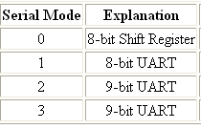
SCON Register
SM0 SM1 SM2 REN TB8 RB8 TI RI
Set when a Cha-
ractor received
Set to Enable
Serial Data
reception
Set when Stop bit Txed
Enable Multiprocessor
Communication Mode
9th Data Bit
Sent in Mode 2,3
9th Data Bit
Sent in Mode 2,3

Slide 69
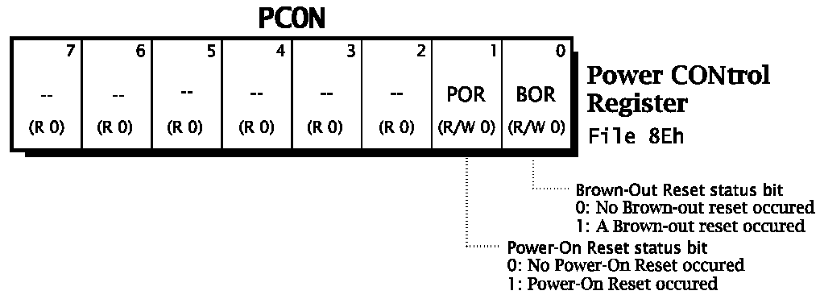
PCON Register

Slide 70
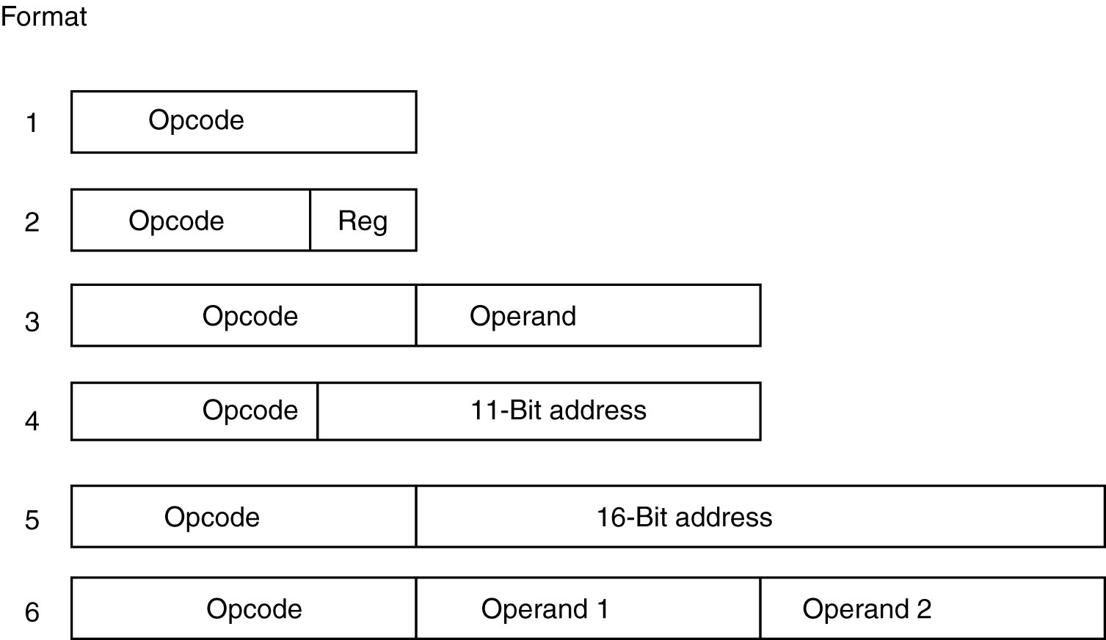
The 8051 Instruction Formats
The 8051 instruction formats.

Slide 71
Addressing Modes
Immediate MOV A,#20h
Register MOV R0, A
Direct MOV A,30h
Register Indirect MOV A,@R0
External Direct MOVX A,@DPTR
Register Indirect with Displacement

Slide 72
Immediate Addressing Mode
MOV A,#65H
MOV R6,#65H
MOV DPTR,#2343H
MOV P1,#65H

Slide 73
Register Addressing mode
The 8051 has eight registers numbered R0-R7. In addition, there are FOUR such banks of registers, only one bank is visible at any one time.
The registers appear in memory, using the first 32 bytes of on-chip data RAM (00-1FH).
Register addressing consists of an opcode. The operand, which specifies which register to use, is part of the opcode byte.

Slide 74
Examples
ADD A, Rn
MOV R0, A ; move the accumulator into R0
MOV 00, A ; as address 00 is R0, move accumulator into R0
MOV DPTR, A
MOV Rm, Rn

Slide 75
Direct Addressing Mode
Direct addressing can access any on-chip variable or hardware register.
An operand specifies the location in on-chip memory to use.
The opcode is followed by a byte operand which specifies the direct address to use.
ADD A, address
All I/O ports and special function registers are assigned addresses between 80H and 0FFH.

Slide 76
To access any byte within first 256 addresses.
MOV A , 088h
Will load Acc with the content of TCON Register at 088
The instruction MOV A, 80H inputs data from PORT 0 and stores it in the ACCUMULATOR.

Slide 77
Register Indirect Addr. Mode
Uses R0 or R1 of each bank as an 8 bit index register to access a byte
MOV A, @R0
This means load the accumulator with the contents of the memory location specified by R0
This mode is identified by @
Using other Bank registers will result in error

Slide 78
External Direct
External Memory is accessed
There are only two commands that use External Direct addressing mode:
MOVX A,@DPTR
MOVX @DPTR,A
DPTR must first be loaded with the address of external memory

Slide 79
Reg Indirect with Displacement
DPTR holds the Displacement
Can be again enhanced with an offset value.

Slide 80
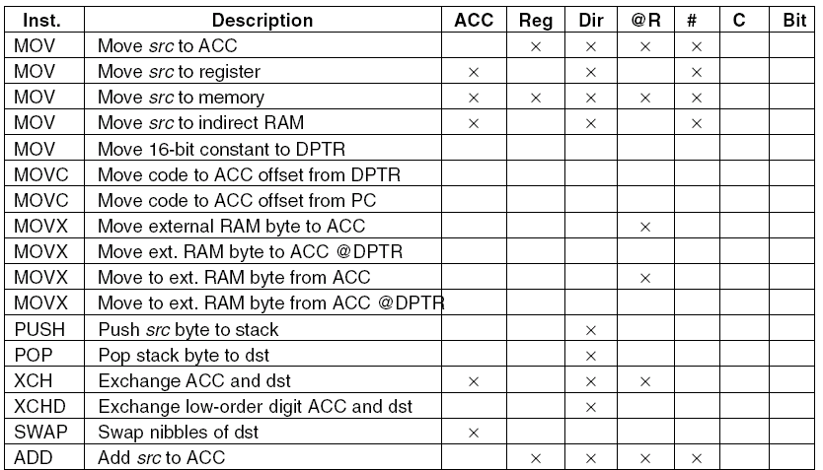
8051 Instructions (1)
The 8051 Instruction set.

Slide 81
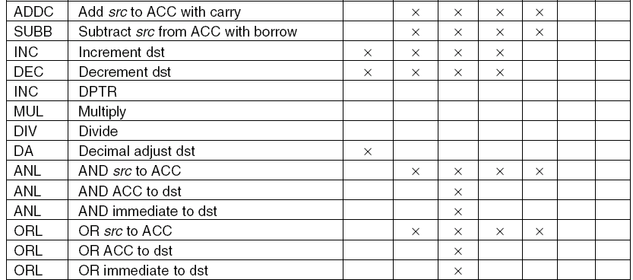
8051 Instructions (2)
The 8051 Instruction set.

Slide 82
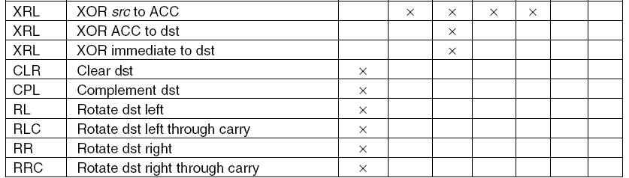
8051 Instructions (3)
The 8051 Instruction set.

Slide 83
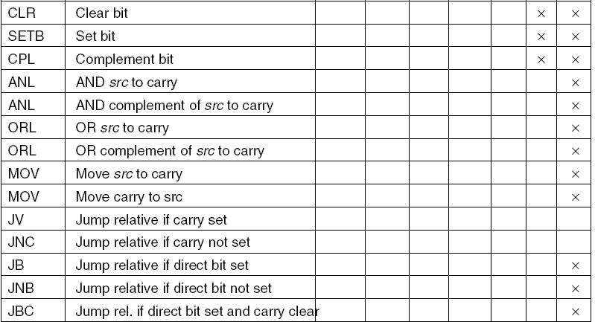
8051 Instructions (4)
The 8051 Instruction set.

Slide 84
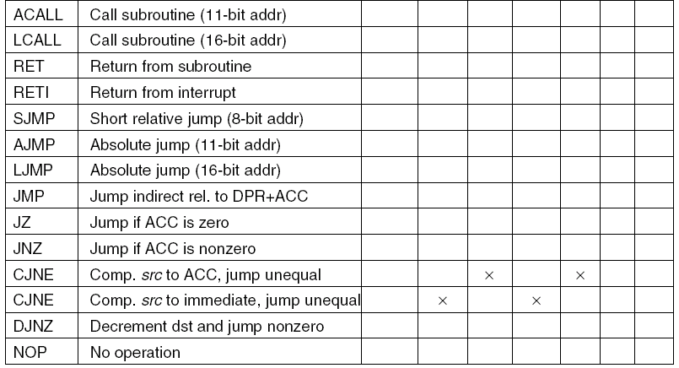
8051 Instructions (5)
The 8051 Instruction set.

Slide 85
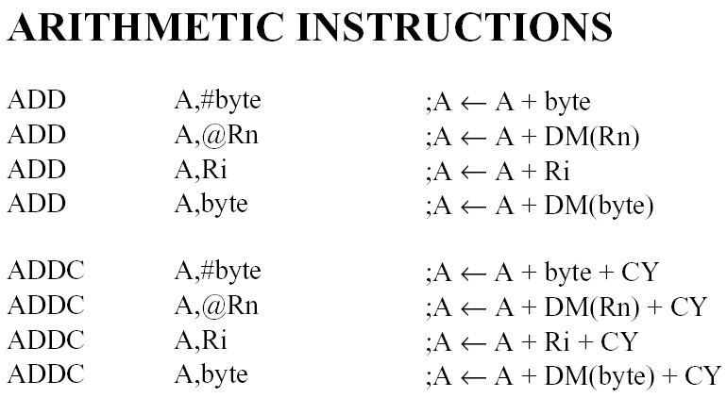

Slide 86
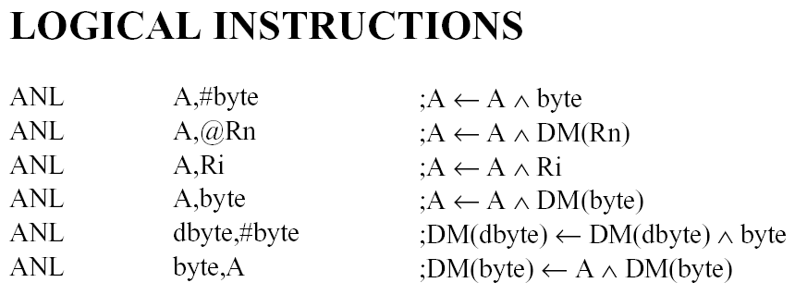
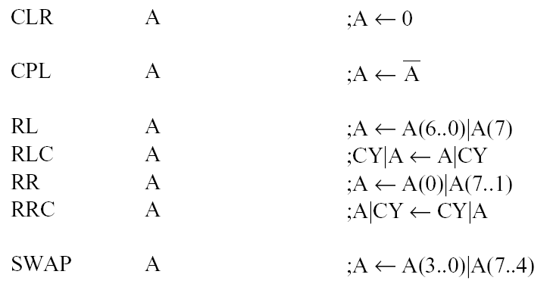

Slide 87
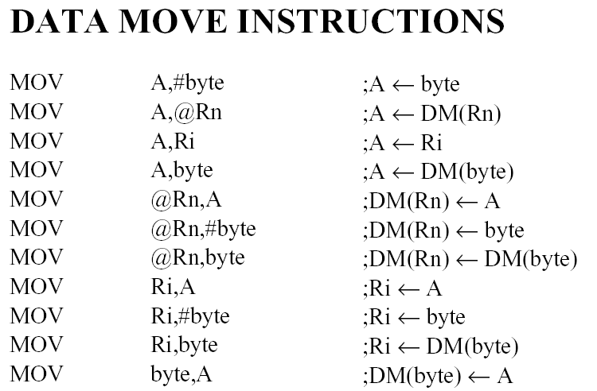

Slide 88
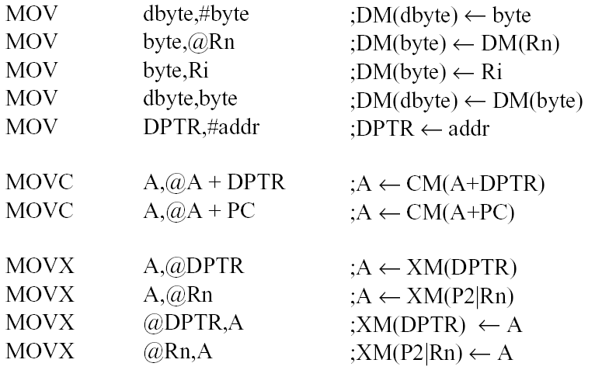

Slide 89



Slide 90

Push, Pop and Exchange

Slide 91


Slide 92


Slide 93


Slide 94


Slide 95


Slide 96


